Slide 1
Agile Methodology
Trainer: Nikhil Shah

Slide 2

Introduction
What is agile?
Agile is a process that allows a team to more efficiently manage a project by breaking it down into several stages, each of which allows for consistent collaboration with stakeholders to promote steady improvements at every stage.
In software development, agile practices involve discovering requirements and developing solutions through the collaborative effort of self-organizing and cross-functional teams and their customer/end user.

Slide 3
12 principles of agile
Customer satisfaction
Early and continuous delivery
Embrace change
Frequent delivery
Collaboration of businesses and developers
Motivated individuals
Face-to-face conversation
Functional products
Technical excellence
Simplicity
Self-organized teams
Regulation, reflection and adjustment

Slide 4
Agile methodology
Agile methodology is a type of project management process, mainly used for software development, where demands and solutions evolve through the collaborative effort of self-organizing and cross-functional teams and their customers.
Agile software development refers to a group of software development methodologies based on iterative development, where requirements and solutions evolve through collaboration between self-organizing cross-functional teams. Agile methods or Agile processes generally promote a disciplined project management process that encourages frequent inspection and adaptation, a leadership philosophy that encourages teamwork, self-organization and accountability, a set of engineering best practices intended to allow for rapid delivery of high-quality software, and a business approach that aligns development with customer needs and company goals.

Slide 5

Examples of Agile Methodology
Agile Scrum Methodology.
Lean Software Development.
Kanban.
Extreme Programming (XP)
Crystal.
Dynamic Systems Development Method (DSDM)
Feature Driven Development (FDD)

Slide 6

scrum
The software development term scrum was first used in a 1986 paper titled "The New Product Development Game". The term is borrowed from rugby, where a scrum is a formation of players. The term scrum was chosen by the paper's authors because it emphasizes teamwork.
Scrum is a subset of Agile. It is a lightweight process framework for agile development, and the most widely-used one.
Scrum is an agile project management methodology or framework used primarily for software development projects with the goal of delivering new software capability every 2-4 weeks.
Scrum is an agile framework for developing, delivering, and sustaining complex products, with an initial emphasis on software development, although it has been used in other fields including research, sales, marketing and advanced technologies.

Slide 7

Agile scrum methodology
Agile scrum methodology is a project management system that relies on incremental development. Each iteration consists of two- to four-week sprints, where each sprint's goal is to build the most important features first and come out with a potentially deliverable product. More features are built into the product in subsequent sprints and are adjusted based on stakeholder and customer feedback between sprints.
Whereas other project management methods emphasize building an entire product in one iteration from start to finish, agile scrum methodology focuses on delivering several iterations of a product to provide stakeholders with the highest business value in the least amount of time.
Agile scrum methodology has several benefits. First, it encourages products to be built faster, since each set of goals must be completed within each sprint's time frame. It also requires frequent planning and goal setting, which helps the scrum team focus on the current sprint's objectives and increase productivity.

Slide 8

Introduction to Scrum Terms
An introduction to Scrum would not be complete without knowing the Scrum terms you'll be using. This section in the Scrum overview will discuss common concepts in Scrum.
Scrum team: A typical scrum team has between five and nine people, but Scrum projects can easily scale into the hundreds. However, Scrum can easily be used by one-person teams and often is. This team does not include any of the traditional software engineering roles such as programmer, designer, tester or architect. Everyone on the project works together to complete the set of work they have collectively committed to complete within a sprint. Scrum teams develop a deep form of camaraderie and a feeling that “we’re all in this together.”

Slide 9
Sprint planning meeting: At the start of each sprint, a sprint planning meeting is held, during which the product owner presents the top items on the product backlog to the team. The Scrum team selects the work they can complete during the coming sprint. That work is then moved from the product backlog to a sprint backlog, which is the list of tasks needed to complete the product backlog items the team has committed to complete in the sprint.
Daily Scrum: Each day during the sprint, a brief meeting called the daily scrum is conducted. This meeting helps set the context for each day’s work and helps the team stay on track. All team members are required to attend the daily scrum.
Sprint review meeting: At the end of each sprint, the team demonstrates the completed functionality at a sprint review meeting, during which, the team shows what they accomplished during the sprint. Typically, this takes the form of a demonstration of the new features, but in an informal way; for example, PowerPoint slides are not allowed. The meeting must not become a task in itself nor a distraction from the process.
Sprint retrospective: Also at the end of each sprint, the team conducts a sprint retrospective, which is a meeting during which the team (including its ScrumMaster and product owner) reflect on how well Scrum is working for them and what changes they may wish to make for it to work even better.
Each of the Scrum terms has its own page within the Scrum section, so be sure to check out all the pages in the navigation.

Slide 10
Lifecycle of Scrum
Sprint: A Sprint is a time-box of one month or less. A new Sprint starts immediately after the completion of the previous Sprint.
Release: When the product is completed then it goes to the Release stage.
Sprint Review: If the product still have some non-achievable features then it will be checked in this stage and then the product is passed to the Sprint Retrospective stage.
Sprint Retrospective: In this stage quality or status of the product is checked.
Product Backlog: According to the prioritize features the product is organized.
Sprint Backlog: Sprint Backlog is divided into two parts Product assigned features to sprint and Sprint planning meeting.

Slide 11

How Scrum Works
In a rugby scrum, all the players literally put their heads together. When it comes to software development, a scrum can be characterized by developers putting their heads together to address complex problems.
Scrum software development starts with a wish list of features — a.k.a. a product backlog. The team meets to discuss:
The backlog.
What still needs to be completed.
How long it will take.
Scrum relies on an agile software development concept called sprints:
Sprints are periods of time when software development is actually done.
A sprint usually lasts from one week to one month to complete an item from the backlog.
The goal of each sprint is to create a saleable product.
Each sprint ends with a sprint review.
Then the team chooses another piece of backlog to develop — which starts a new sprint.
Sprints continue until the project deadline or the project budget is spent.
In daily scrums, teams meet to discuss their progress since the previous meeting and make plans for that day.
The meetings should be brief — no longer than 15 minutes.
Each team member needs to be present and prepared.
The ScrumMaster keeps the team focused on the goal.

Slide 12
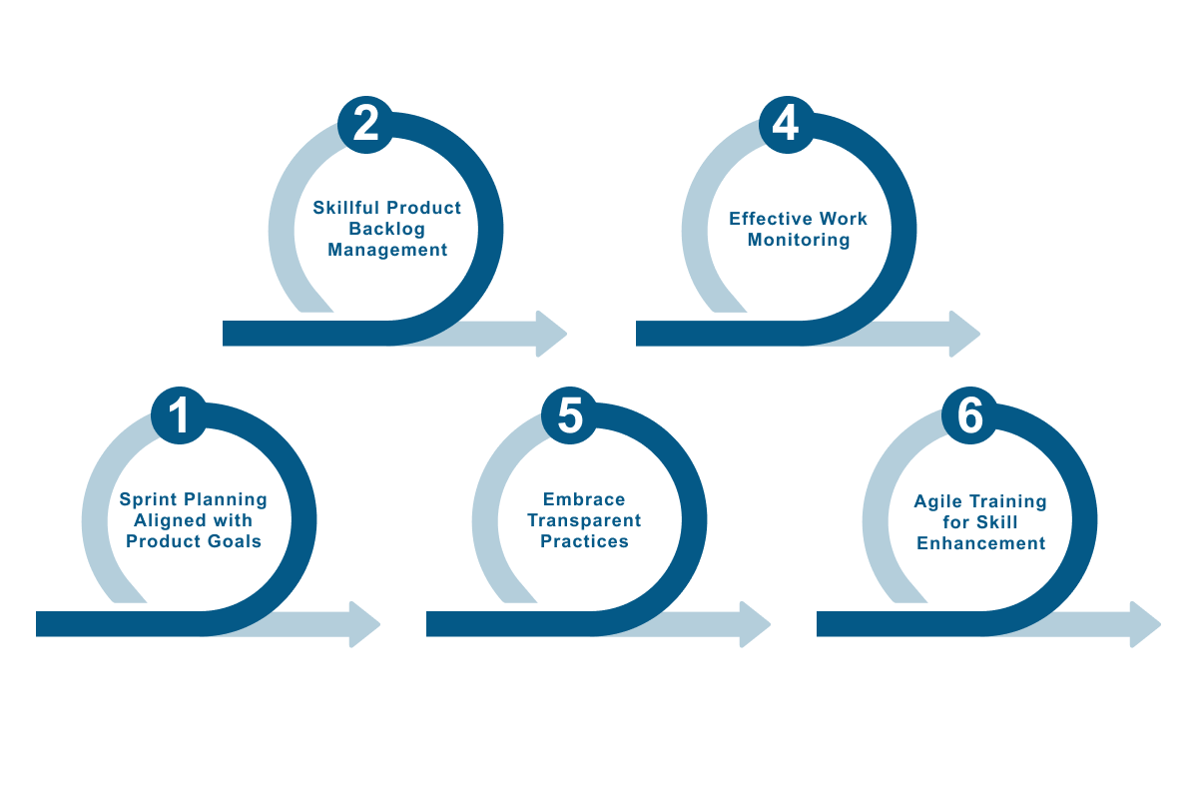
How Scrum Works

Slide 13
Who is in the Scrum?/Scrum Terms
Product owner: The product owner is the project’s key stakeholder and represents users, customers and others in the process. The product owner is often someone from product management or marketing, a key stakeholder or a key user.
Scrum Master: The Scrum Master is responsible for making sure the team is as productive as possible. The Scrum Master does this by helping the team use the Scrum process, by removing impediments to progress, by protecting the team from outside, and so on.
Product backlog: The product backlog is a prioritized features list containing every desired feature or change to the product. Note: The term “backlog” can get confusing because it’s used for two different things. To clarify, the product backlog is a list of desired features for the product. The sprint backlog is a list of tasks to be completed in a sprint.

Slide 14
At the start of each sprint, the team selects some amount of work from the product backlog and commits to completing that work during the sprint. Part of figuring out how much they can commit to is creating the sprint backlog, which is the list of tasks (and an estimate of how long each will take) needed to deliver the selected set of product backlog items to be completed in the sprint.
At the end of each sprint, the team produces a potentially shippable product increment — i.e. working, high-quality software. Each day during the sprint, team members meet to discuss their progress and any impediments to completing the work for that sprint. This is known as the daily scrum, and is shown as the smaller green circle above.
Scrum is the type of Agile framework. It is a framework within which people can address complex adaptive problem while productivity and creativity of delivering product is at highest possible values. Scrum uses Iterative process.

Slide 15
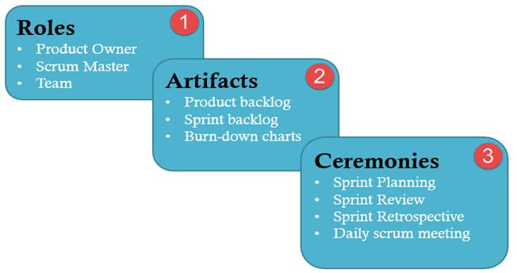
Key Features of Scrum Methodology
Scrum has a short fixed schedule of release cycles with adjustable scope known as sprints to address rapidly changing development needs. Each release could have multiple sprints. Each Scrum Project could have multiple Release Cycles.
A repeating sequence of meetings, events, and milestones
A practice of testing and implementing new requirements, known as stories, to make sure some work is released ready after each sprint

Slide 16
Who can benefit from scrum?
While scrum can benefit a wide variety of businesses and projects, these are the most likely beneficiaries:
Complicated projects: Scrum methodology is ideal for projects that require teams to complete a backlog.
Companies that value results: Scrum is also beneficial to companies that value results over the documented progress of the process.
Companies that cater to customers: Scrum can help companies that develop products in accordance with customer preferences and specifications.

Slide 17
What are the benefits of agile scrum methodology?
Here are some of the collective benefits of agile scrum methodology:
Flexibility and adaptability
Creativity and innovation
Lower costs
Quality improvement
Organizational synergy
Employee satisfaction
Customer satisfaction

Slide 18

Benefits of Scrum
Rugby players try to gain control of the ball in the scrum and move it downfield. Software developers use scrum to move their projects quickly. And the benefits trickle down to software developers:
Developers who want the freedom to make decisions thrive in scrum teams. Team morale tends to be high.
Each sprint produces a product that is ready for market even though the project is ongoing. The highest priority requirements are addressed first so a high-quality, low-risk product can be on the market.
The incremental process shortens the time to market by about 30 percent to 40 percent. Because the product owner is part of the scrum team, requirements can be delivered as they are needed.
Scrum projects often realize a higher return on investment (ROI). This is attributed to:
Decreased time to market.
Early and regular feedback that prompts course corrections early when they are less costly.
Defects that are fewer and less costly.
Projects failing early and quickly when it’s less costly.
Reviewing each sprint before the team moves on to the next sprint spreads testing throughout development.
Project focus and goals can change with evolving business goals.

Slide 19
Disadvantages of Scrum
While a rugby scrum may get rough and bloody, software developers shouldn’t have to worry about that. Nonetheless, scrum is not for all developer teams or software development projects. There are disadvantages to implementing scrum projects:
There is a danger of scope creep if stakeholders keep adding functionality to the backlog. This could be encouraged by the fixed deadline.
Scrum works best with small teams of experienced software developers. They need to be able to work quickly.
Scrum teams do not work well when the scrum master micromanages their work.
Losing any team members can hurt the progress of the project.

Slide 20

Scrum Best Practices
Teamwork wins rugby games and helps software developers create quality products. To get the best quality out of scrum:
Define requirements just in time to keep product features as relevant as possible.
Test and incorporate product owner feedback daily.
Sprint reviews with stakeholders need to be regular.
The scrum team needs to use the sprint retrospectives to improve how they work.
Conduct face-to-face conversations to reduce miscommunications.
Trust the teams to do the best job possible.
Allow the teams to self-organize around people’s skills, work styles and personalities.
Don’t burn out the team members. Respect the balance between their personal and professional lives to ease stress.

Slide 21

Role of test engineer in scrum team
The tester should be actively engaged in the team's work during the Sprint and meetings. It is the tester's role to ensure the quality of the developed product and the delivery process itself
The development team in Scrum is responsible for developing the product by working closely with the Product Owner. As per the testing quadrants, the testers are responsible for technology-facing tests that support team & critique the product and business-facing tests that help the team & critiques the product.
Even though an entire Scrum team has responsibility for testing and code quality, someone on the team needs to be good at testing, and someone on the team needs to set up unit and regression test automation, run the end-to-end integration tests, and do manual exploratory testing on the whole product

Slide 22
Scrum in Software Testing
Scrum in Software Testing is a methodology for building complex software applications. It provides easy solutions for executing complicated tasks. Scrum helps the development team to focus on all aspects of the software product development like quality, performance, usability and so on. It provides with transparency, inspection and adaptation during the software development to avoid complexity.

Slide 23
Scrum Testing
Scrum Testing is a testing done in scrum methodology to verify the software application requirements are met. It involves checking non-functional parameters like security, usability, performance etc. There is no active role of tester in the process so it is usually performed by developers with Unit Test. Sometimes dedicated test teams are needed depending on nature & complexity of project.

Slide 24
Role of test engineer in scrum team
1) Attend sprint-planning sessions
01
2) Attend daily stand-ups.
02
3) Don’t save all the testing for the end; test throughout the sprint.
03
4) Meet with developers for short hand-off demonstrations.
04
5) Attend sprint retrospectives
05
6) Document Test cases
06

Slide 25
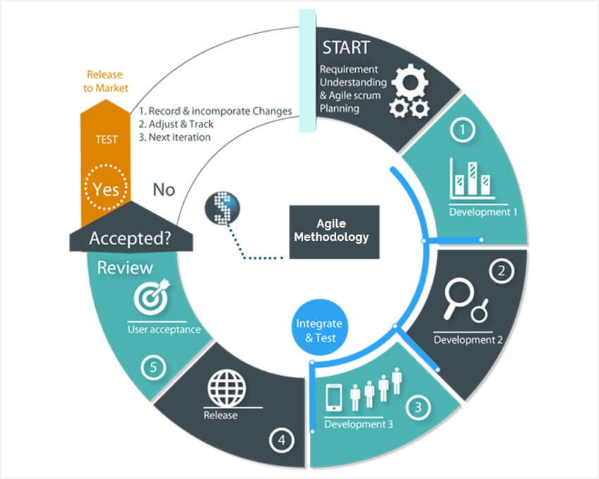
What is the role of a QA tester on a Scrum team?

Slide 26
What is the role of a QA tester on a Scrum team?
Face – To – Face Communication:
Face to face discussion with the team is the most efficient way to communicate ideas to the time. A tester participates in Planning/ Release of the Sprint: The design meetings are held every time before the sprint planning is done. The testers can participate in this meeting and ask questions on the stories being discussed. The tester should make a model in his mind about how the system would look and work based on the discussions.
Capability to find ambiguity:
The tester would work collaboratively and productively with the product owner and the customer to form acceptance criteria. An agile tester would be able to describe the feature well. Before any user story is sent for development the tester and other team members would discuss the complete user story with the team member to find out what the customer wants.
Absolute Role:
The tester should have good interpersonal skills .Tester should have Technical skills apart from that he should have good communication skills to deliver the project to the client . This shows that the tester should have a broader range of functionality.

Slide 27

What is the role of a QA tester on a Scrum team?
Technical Skills:
An agile tester understands the relevance of technical skills. He/She is always prepared to contribute to the technical discussions of the team. His contribution may extend up to code reviews, user stories grooming, requirements understanding. The Agile Software Tester would work with the developers when they are performing unit testing and share the perspective of testing from a tester point of view instead of developer point.
Automation:
Agile testing involves automation at the time of unit testing and integration testing. For automation There are many tools available for automation which does not require prior training for language.
Exploratory Tester:
The skill of exploratory testing is a very useful and powerful method sometimes in the agile process. An exploratory tester can utilize his skills to perform testing avoiding risks and uncertainty in the product. The tester can get ideas from the initial design discussions and the meetings with the team to uncover the system and explore more in the system. Once the tester is able to find out the areas of ambiguity the tester can work more systematically and efficiently in the product. An agile tester should share their knowledge and information with the rest of the scrum team.

Slide 28

What are the various activity on scrum process
sprint meeting : Which Item should be picked from backlogs and estimated time for developing the component. It should also on the prioritizing the work.
Daily scrum : In daily scrum meeting tester should get the information about previously done tasks and also do plan for next task to deliver the developer.
Daily work : Tester should perform acceptance test ,system test and on the unit test and integration test tester should perform Automation test on the Daily work of the current sprint

Slide 29
In Review and Retrospection meeting
The tester needs to identify what went wrong and what went right in the current sprint
He needs to learn new lessons and best practices from the current sprint
The tester is encouraged to write new user stories that would help in testing and also user stories that would help the customer
The tester will discuss like if any user story was not covered in current sprint.
Any obstructions in the project will be put under consideration of Scrum Master.

